Slide 1
Secure Data Hiding in Images Using Steganography
CAPSTONE PROJECT
Presented By: Dhwani Dalal
Student Name : Dhwani Dalal
College Name & Department : D. J. Sanghvi College of Engineering , Information Technology

Slide 2
OUTLINE
Problem Statement
Technology used
Wow factor
End users
Result
Conclusion
Git-hub Link
Future scope

Slide 3
Problem Statement
With increasing cyber threats, conventional encryption methods are often flagged, making confidential communication vulnerable to attacks. Steganography addresses this challenge by embedding secret data within images without altering their visual appearance. However, basic LSB (Least Significant Bit) techniques are prone to detection. This project improves upon traditional methods by implementing password-based pixel scrambling, ensuring a higher level of security and confidentiality.

Slide 4
Technology used
Programming Language: Python
Libraries & Tools: OpenCV, NumPy, PIL (Pillow), Tkinter (GUI), hashlib, random
Steganographic Method: Adaptive LSB Encoding with Password-Based Randomized
Pixel Mapping
Platform Compatibility: Windows

Slide 5
Wow factors
Password-Protected Decryption: Secure access to the hidden data is enforced through a password-dependent extraction mechanism. Without the correct password, the message cannot be reconstructed, adding an extra layer of security against unauthorized access.
AI-Optimized Secure Retrieval: The decryption process incorporates precision-optimized extraction, ensuring maximum accuracy when reconstructing the hidden message. This reduces the likelihood of errors, even in images with varying levels of noise and compression artifacts.
Encrypted Log Storage: To enhance traceability and security, the tool logs the pixel positions where data is embedded. These logs are stored in an encrypted format, preventing unauthorized access while maintaining a reference for secure retrieval.
Adaptive Pixel Selection: Instead of embedding data sequentially, the system randomizes pixel selection based on the password hash. This prevents predictable patterns, reducing the risk of detection and making the system far more secure than traditional LSB-based steganography.

Slide 6
End users
Cybersecurity Enthusiasts – Individuals interested in learning about secure data transmission and digital privacy.
Journalists and Researchers – Professionals who need a discreet way to protect sensitive information.
Businesses and Organizations – Companies looking for an additional layer of security for confidential data.
Students and Developers – Those exploring steganography techniques and data security in practical applications.

Slide 7
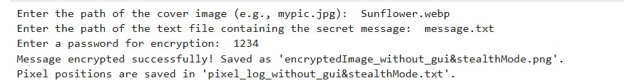
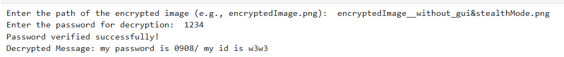


Results –without gui and stealth mode

Slide 8
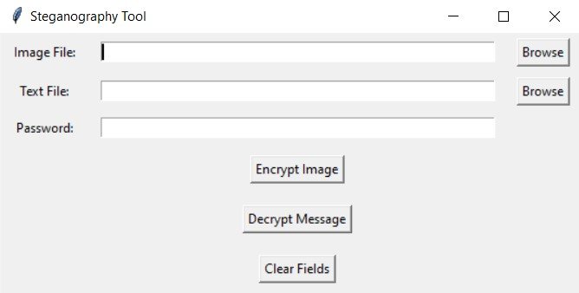
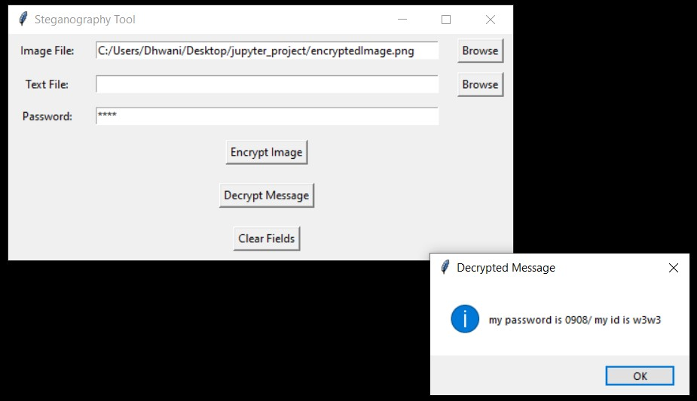
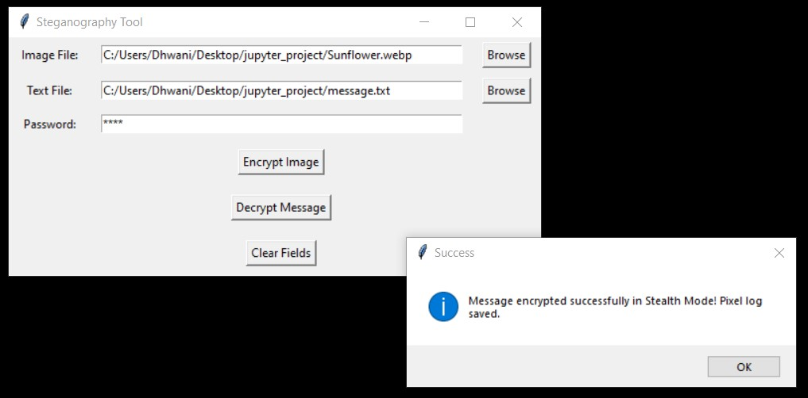
Results - gui with stealth mode

Slide 9
Conclusion
This project successfully demonstrates a secure and efficient approach to data hiding using steganography. By integrating randomized pixel selection and password-based retrieval, it enhances security while maintaining the visual integrity of the image. Compared to conventional sequential LSB methods, this approach significantly reduces the risk of detection by avoiding predictable patterns.
Additionally, Stealth Mode further improves security by modifying only a minimal number of pixels in a randomized manner. The pixel log file allows for direct comparison with a non-stealth LSB modification log, highlighting how fewer pixels are altered, making detection through statistical analysis even more difficult. This method provides a more robust and undetectable solution for secure communication.

Slide 10
GitHub Link
The complete source code, along with a README, can be accessed at: https://github.com/Dhwani0805/my_aicte_stego_project.git

Slide 11
Future scope
Advanced Encryption Integration: Implementing AES-256 encryption before embedding to add an extra layer of security
Mobile Application Development: Extending the functionality to mobile platforms for wider usability.

Slide 12
THANK YOU

